Slide 1
THE FUTURE FILTER
Tom & Enzo

Slide 2

Poster
Main Menu

Slide 3
Package Used
Tkinter
PIL
Open CV
Numpy

Slide 4
01
02
03
OOP
Files Finding
Files Reading

Slide 5
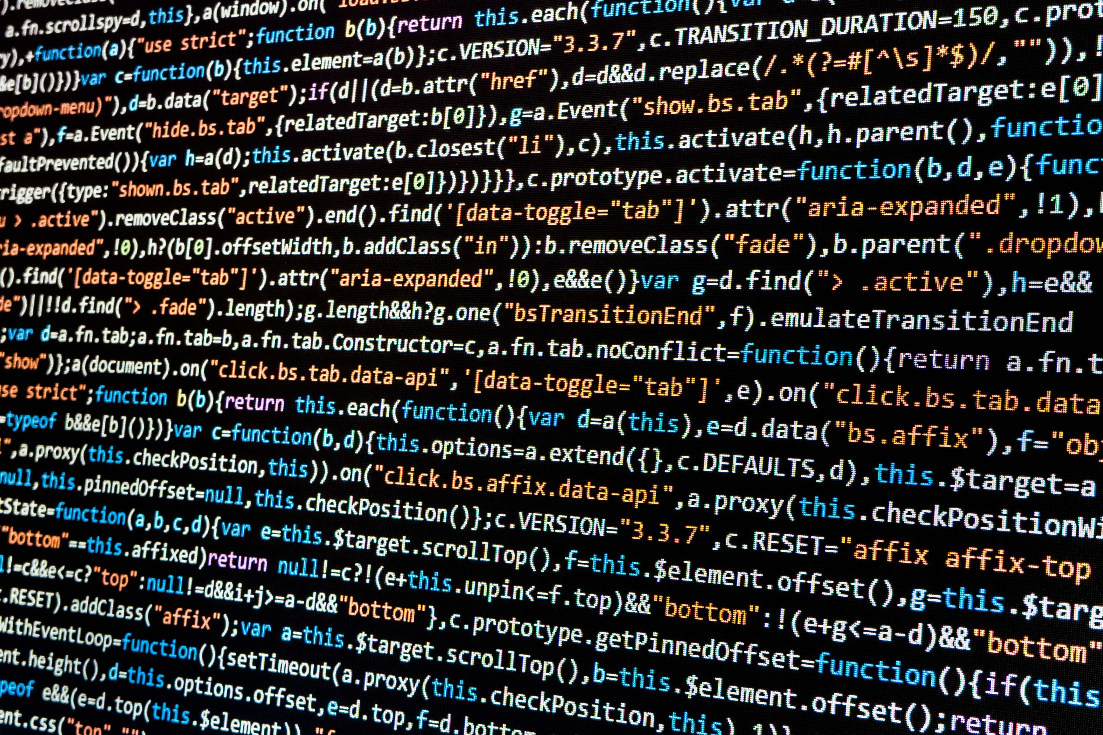
Algorithms
HSV Adjustment
Image Gradient
Threshold
Canny Edge Detection
Image Smoothing

Slide 6
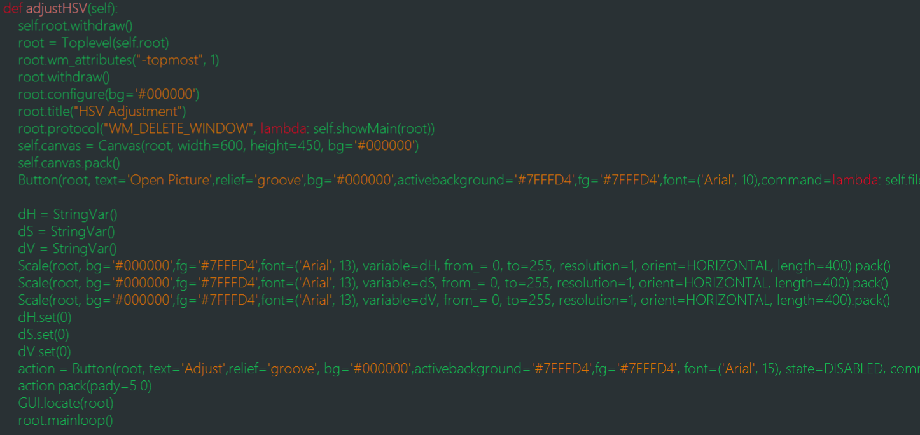
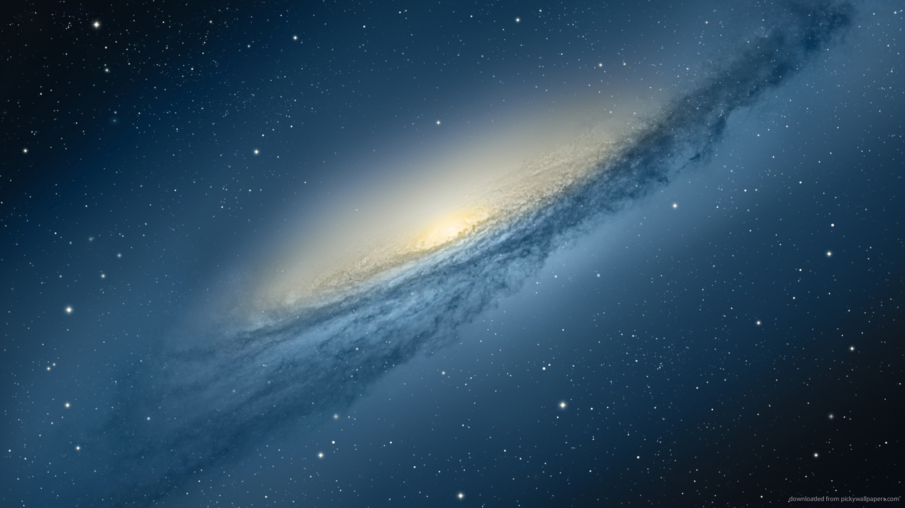
HSV Adjustment

Slide 7
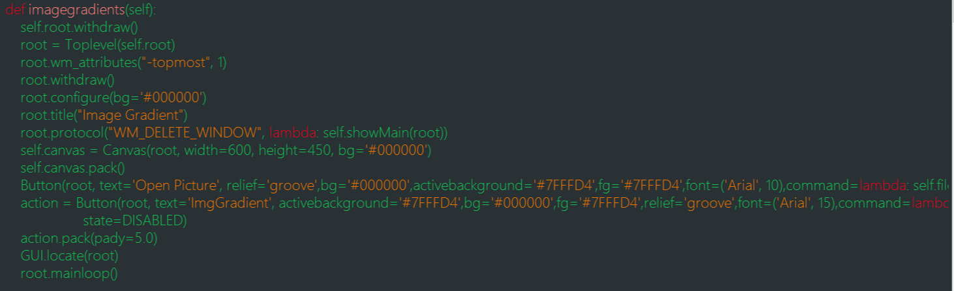
Image Gradient

Slide 8
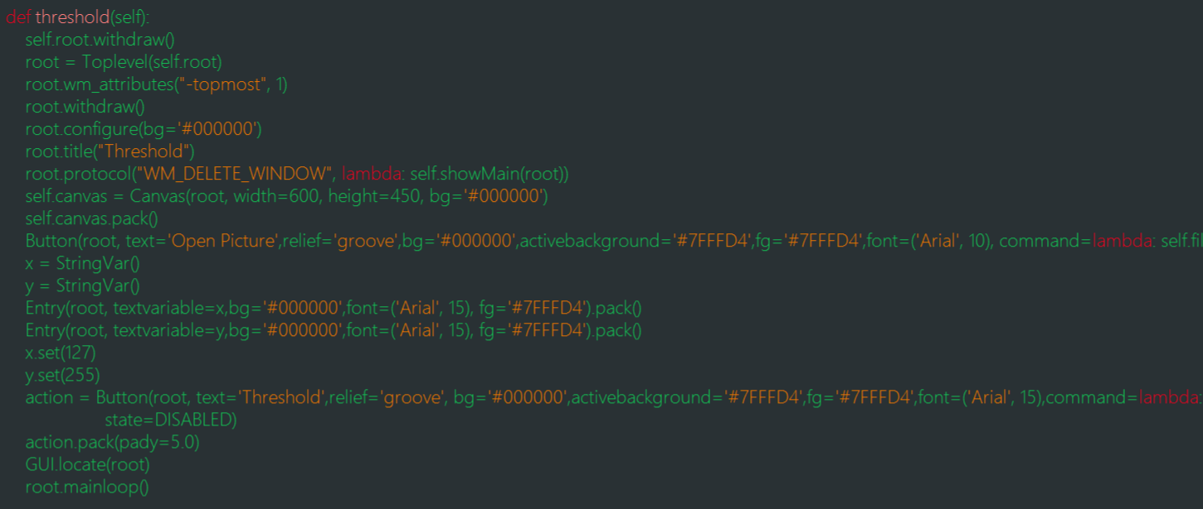
Threshold

Slide 9
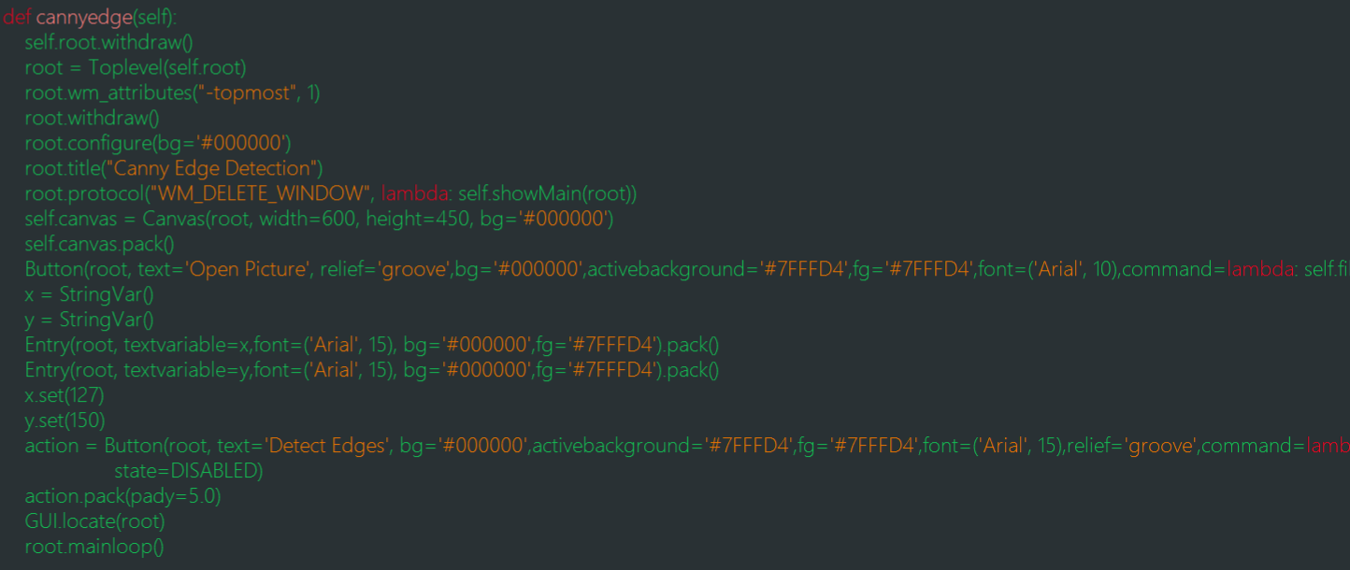
Canny Edge

Slide 10
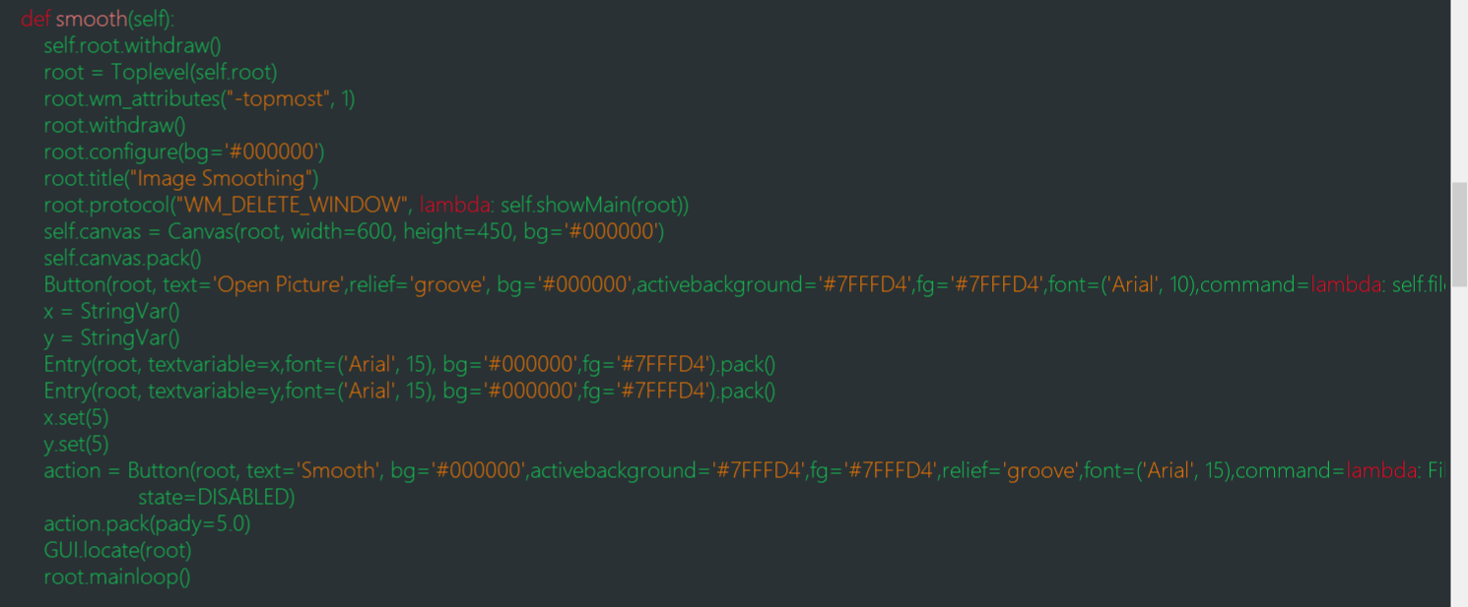
Image Smoothing

Slide 11
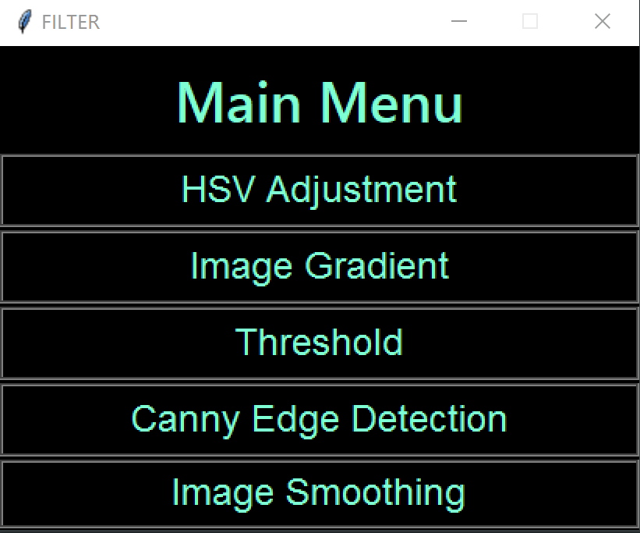
GUI
“Future Style”

Slide 12
Thank you all for listening!

